Slide 1

Medicago Talent Retention Analysis -A subsidiary of Mitsubishi Tanabe Pharma Corporation
Simple metric comparisons , Attrition & Salary Predictions
DDSAnalytics
Yat Leung

Slide 2

Attrition
Factors in US workplace turnover:
Personal/Family (57%)
Promotion Opportunity (35%)
Career Change (27%)
Base Salary (24%)
Job Satisfaction (24%) https://www.imercer.com/content/article/employee-turnover.aspx
In 2018, 44% Separation Rate was reported by the Department of Labor. -https://www.bls.gov/news.release/jolts.t16.htm

Slide 3

Turnover Reasons Within Medicago
Identify three major causes
Attrition & Salary
Salary is 1 out of 5 factors associated with attrition.
Estimated 16% of employees left the company since data was compiled.
Performed 2 separate regression models with attrition and salary as the responses.
Common Turnover Factors in Medicago:
DistanceFromHome
NumCompaniesWorked
YearsInCurrentRole

Slide 4

Predicting Turnover
A preventive approach to retain talents through KNN regression and classification

Slide 5
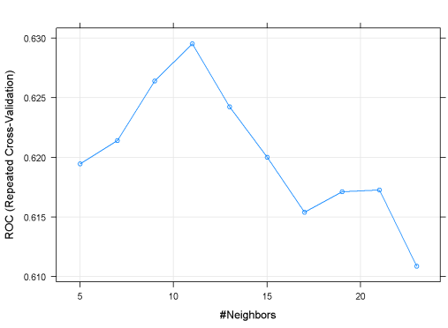
KNN Regression
Determine the optimal K coefficient, Model Setup and Metrics
Finding the optimal K coefficient
3 Repeated 10-fold cross validation with the train model on the entire data set.
Optimal K =11, chosen based on the highest ROC value
Split the data set into a Train and Test case (60/40)
Model Metrics
Sensitivity : 0.9354
Specificity : 0.1667
Accuracy : 0.8161

Slide 6
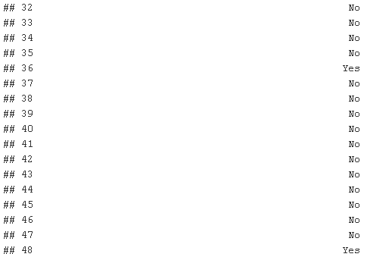
KNN Classification
Model Validation
Probability of Attrition
Validation Set Prediction Sample
Prediction calculates the probability of attrition
Convert the probability into a binary (Yes/No)
Threshold value of >=0.5
If Pr(Attrition) <0.5, classify as No attrition
If Pr(Attrition) >=0.5, classify as Yes attrition

Slide 7
Salary
Benefits of a good salary structure:
Hire best talent
Increase productivity
Improve Recruitment
Increase Retention
A look at salary prediction through GLM modeling

Slide 8
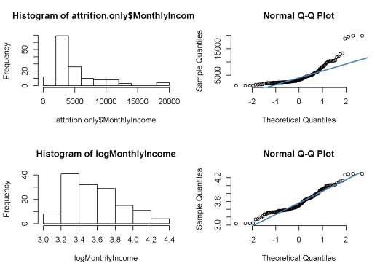
Salary GLM Modeling
A linear modeling approach to determine salary (MonthlyIncome)
Monthly Income
MonthlyIncome is a right skewed distribution.
Log₁₀ on MonthlyIncome to transform into a normal like data to use in the model.
Independent Variables used:
 | VIF (Variance Inflation Factor)
DistanceFromHome | 1.006176
NumCompaniesWorked | 1.295791
TotalWorkingYears | 2.131392
YearsAtCompany | 4.437212
YearsInCurrentRole | 2.738231
YearsWithCurrManager | 2.632119

Slide 9
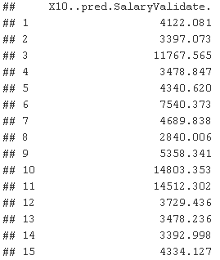
Salary GLM Modeling
Train & Test Models RMSE
Assess the model fit on the Train and Test (60/40)
RMSE <0.3
Predictions based on log Monthly Income
Transform predictions by raising to the power of 10.
 | RMSE
Train Set | 0.1924328
Test Set | 0.1893982

Slide 10
Job Roles and Satisfaction
A brief comparison on job roles and satisfaction ratings

Slide 11
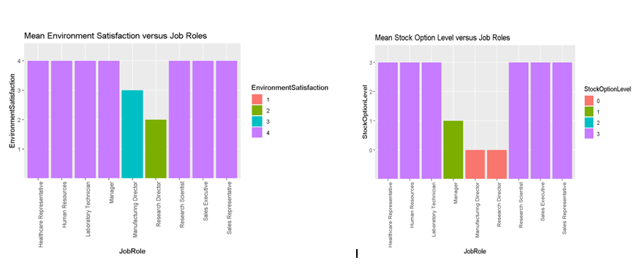
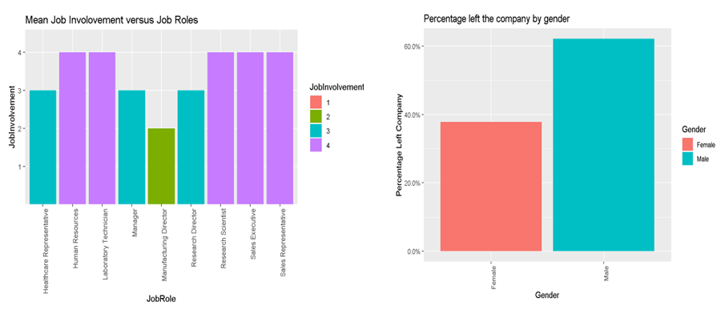
Compare job roles and average satisfaction ratings
The job roles versus satisfaction plots plotted the average satisfaction ratings of the employees who left the company.
In terms of environment satisfaction, Research Director has the lowest rating (2) followed by Manufacturing Director (3).
Stock option level rating were 0 for both Research Director and Manufacturing Director. Followed by manager rated it at 1.
On average, Manufacturing Director has the lowest job involvement rating compared to others within the company.
Of those who left the company, there was a much higher attrition percentage of men than women. (>20%)

Slide 12

Thank You

